Slide 1

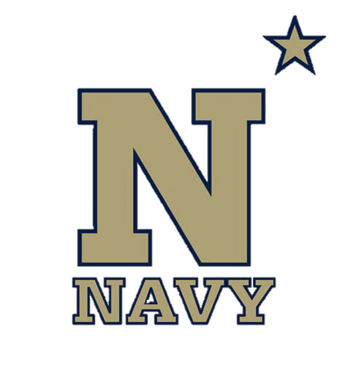
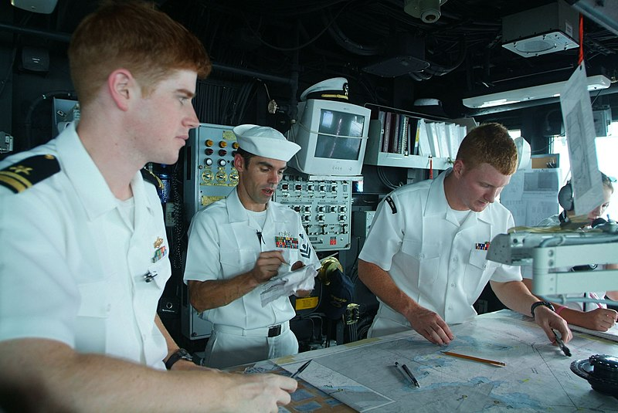
Introduction to Marine Navigation
NN220-01
SEANAV I United States Naval Academy
NN22- – Fundamentals of Navigation– Updated May 23
Operations Officer I HMS PROTECTOR A173 I The Ice Patrol Ship

Slide 2
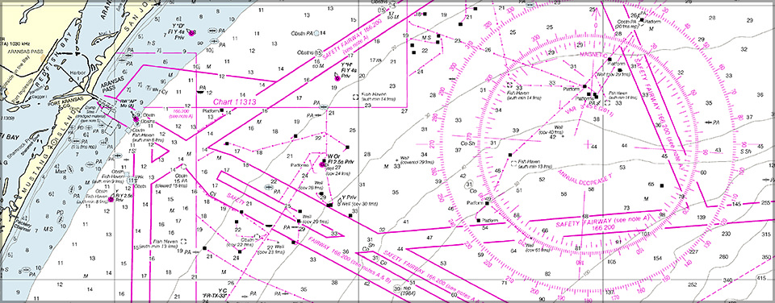
References
-The American Practical Navigator, Pub. No. 9, Bowditch, VOL. 1, 2019 Edition -Surface Ship Navigation Department Organizations and Regulations Manual (NAVDORM), COMNAVSURFPAC/COMNAVAIRPAC/COMNAVAIRLANT/COMNAVSURFLANT INSTRUCTION 3530.4 series
SEANAV I United States Naval Academy
NN220 – Fundamentals of Navigation
Operations Officer I HMS PROTECTOR A173 I The Ice Patrol Ship

Slide 3
Enabling Objectives
1 – DESCRIBE the purpose of the American Practical Navigator (PUB 9) and its impact on maritime navigation. 2 - UNDERSTAND US Navy policy towards navigation as detailed in NAVDORM.
3 - UNDERSTAND the art and science of navigation.
4 – DEFINE the terms Nautical Charts, Course, Heading, Bearing, Speed, Lines of Position, Fix, Prime Meridian, Longitude, Equator, Latitude, Rhumb Line and Great Circle Line. 5- UNDERSTAND the Terrestrial Coordinate System.
6 – IDENTIFY the different types of Navigation.
7 – DEFINE the terms Dead Reckoning, Piloting, RADAR Navigation, Satellite Navigation, and Celestial Navigation.
8 – DESCRIBE the four phases of Navigation.
9 – DESCRIBE Table 3-A.
10 – DESCRIBE the U.S. based organizations that regulate navigation.
11 – DESCRIBE the International organizations that regulate navigation.
12 – UNDERSTAND the U.S. Navy’s role in Navigation.
SEANAV I United States Naval Academy
NN220 – Fundamentals of Navigation
Operations Officer I HMS PROTECTOR A173 I The Ice Patrol Ship

Slide 4

Why Navigation?
Why do we learn it?
SEANAV I United States Naval Academy
NN220 – Fundamentals of Navigation
Operations Officer I HMS PROTECTOR A173 I The Ice Patrol Ship

Slide 5
Why Navigation?
Mission Statement The United States is a maritime nation, and the U.S. Navy protects America at sea. Alongside our allies and partners, we defend freedom, preserve economic prosperity, and keep the seas open and free. Our nation is engaged in long-term competition. To defend American interests around the globe, the U.S. Navy must remain prepared to execute our timeless role, as directed by Congress and the President.
https://www.navy.mil/About/Mission/
SEANAV I United States Naval Academy
NN220 – Fundamentals of Navigation
Operations Officer I HMS PROTECTOR A173 I The Ice Patrol Ship

Slide 6
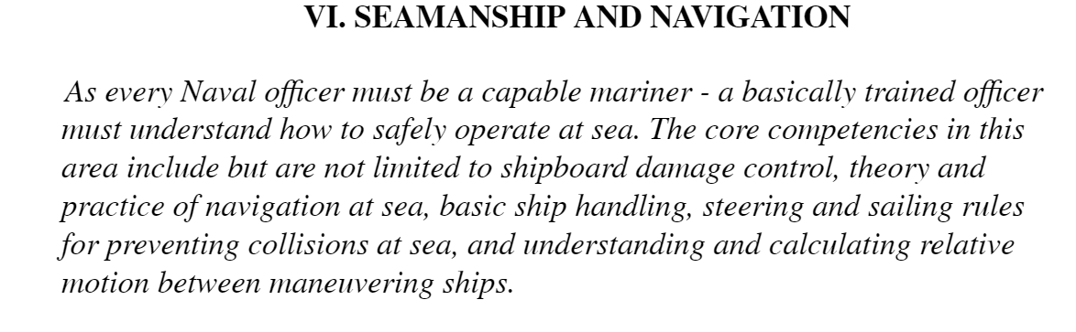
Professional Core Competencies
SEANAV I United States Naval Academy
NN220 – Fundamentals of Navigation
Operations Officer I HMS PROTECTOR A173 I The Ice Patrol Ship

Slide 7
Why Navigation?
-The US Navy operates ships at sea. -Our mission is directly related to the maritime domain. -In order to execute our mission, we must master the ability to safely navigate our assets around the world. -As future Officers of the US Navy…this is YOUR business!
SEANAV I United States Naval Academy
NN220 – Fundamentals of Navigation
Operations Officer I HMS PROTECTOR A173 I The Ice Patrol Ship

Slide 8
Key References
-The American Practical Navigator. -The US Navy policy on Surface Navigation, the NAVDORM.
SEANAV I United States Naval Academy
NN220 – Fundamentals of Navigation
Operations Officer I HMS PROTECTOR A173 I The Ice Patrol Ship

Slide 9
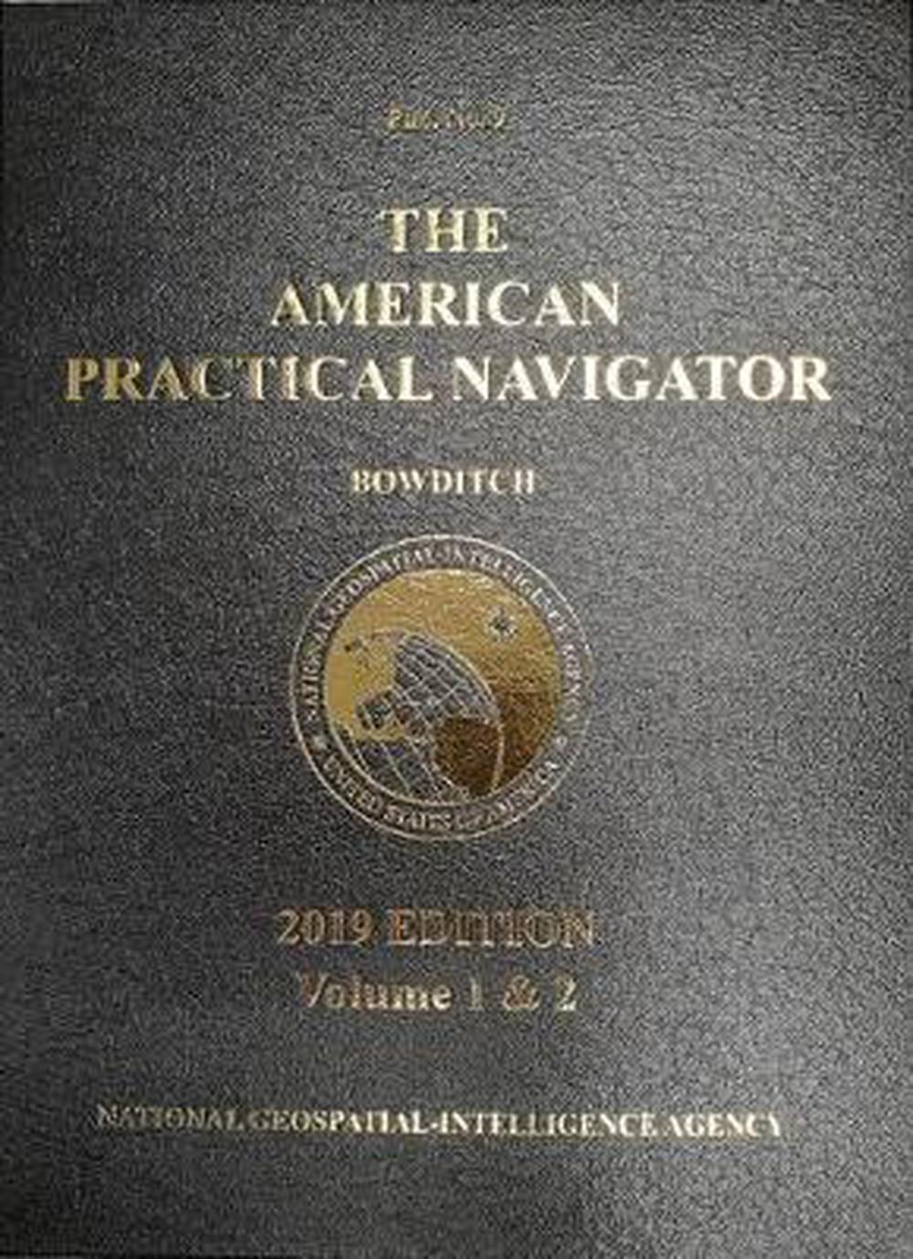
The American Practical Navigator
-Pub. No 9
-“Bowditch”
-Premier encyclopedia of navigation.
-Valuable handbook on oceanography and meteorology.
-First edition in 1772 (then called the Practical Navigator).
-Prepared and produced by National Geospatial-Intelligence Agency (NGA) and available free online.
SEANAV I United States Naval Academy
NN220 – Fundamentals of Navigation
Operations Officer I HMS PROTECTOR A173 I The Ice Patrol Ship

Slide 10
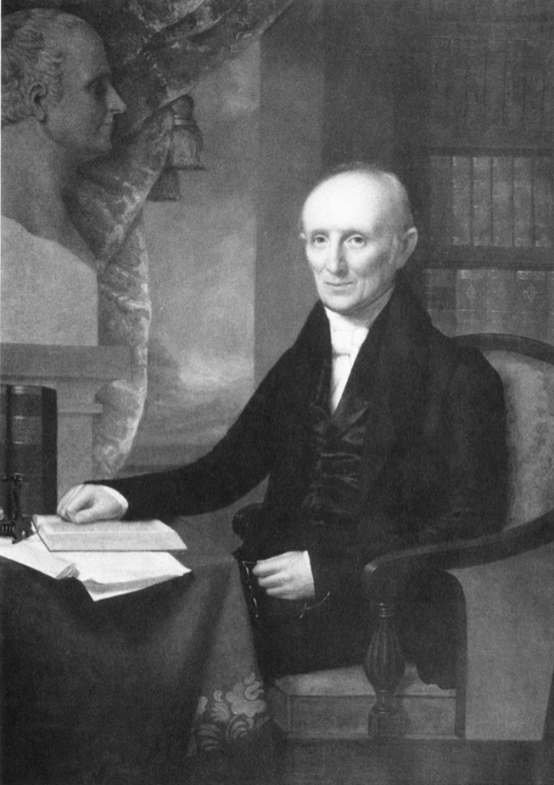
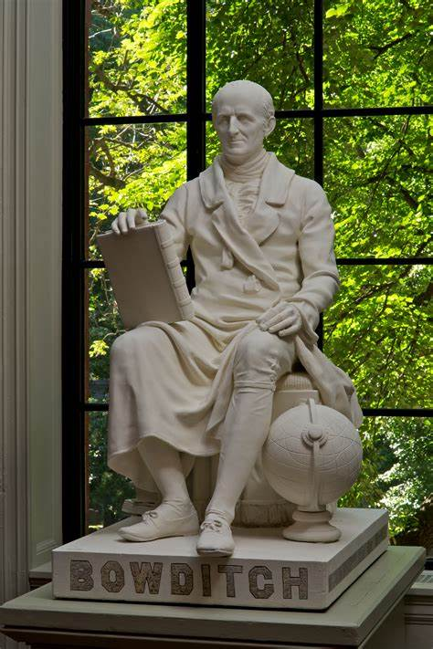
Nathaniel Bowditch
SEANAV I United States Naval Academy
NN220 – Fundamentals of Navigation
Operations Officer I HMS PROTECTOR A173 I The Ice Patrol Ship

Slide 11
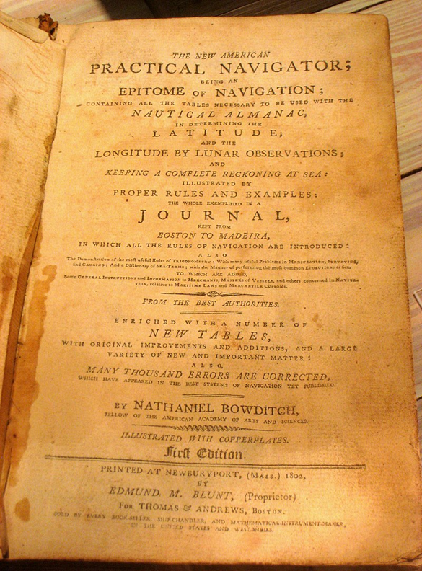
Nathaniel Bowditch
-March 26th 1773 – March 16th 1838
-Born in Salem, MA.
-Taught himself Calculus at 16 and Latin at 17.
-In 1795, went to sea and by 1803 was a master mariner.
-Spent much of his time at sea obsessed with mathematics and celestial navigation.
-ID’d many errors in John Hamilton Moore’s
Practical Navigator.
-U.S. Publisher asked Bowditch to correct these errors.
-The corrected edition was published in 1799.
-Renamed the American Practical Navigator in 1802.
-Tome is referred to as “Bowditch” to honor the work he accomplished in navigation.
SEANAV I United States Naval Academy
NN220 – Fundamentals of Navigation
Operations Officer I HMS PROTECTOR A173 I The Ice Patrol Ship

Slide 12
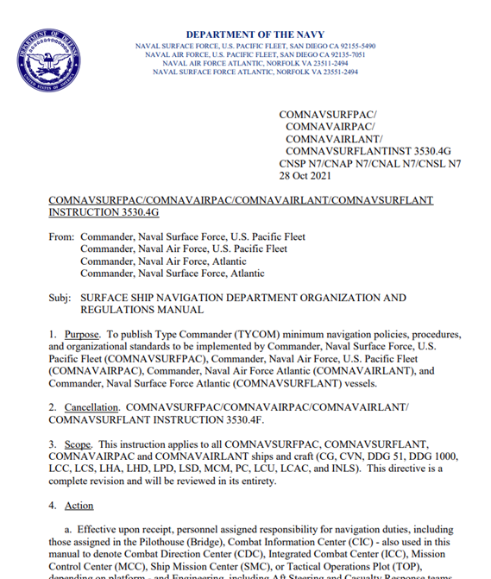
SURFACE SHIP NAVIGATION DEPARTMENT ORGANIZATION AND REGULATIONS MANUAL
-US Navy policy on navigation.
-Shortened to NAVDORM.
-Details MINIMUM navigation policies, procedures and organizational standards.
-Applicable to all surface ships and craft.
-Ship will tailor version to their ship called the Ship’s Navigation Bill, or NAVBILL.
SEANAV I United States Naval Academy
NN220 – Fundamentals of Navigation
Operations Officer I HMS PROTECTOR A173 I The Ice Patrol Ship

Slide 13
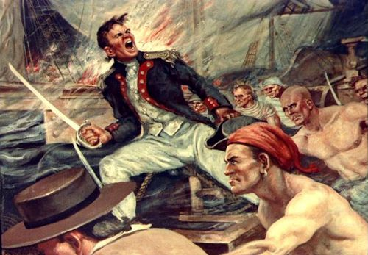
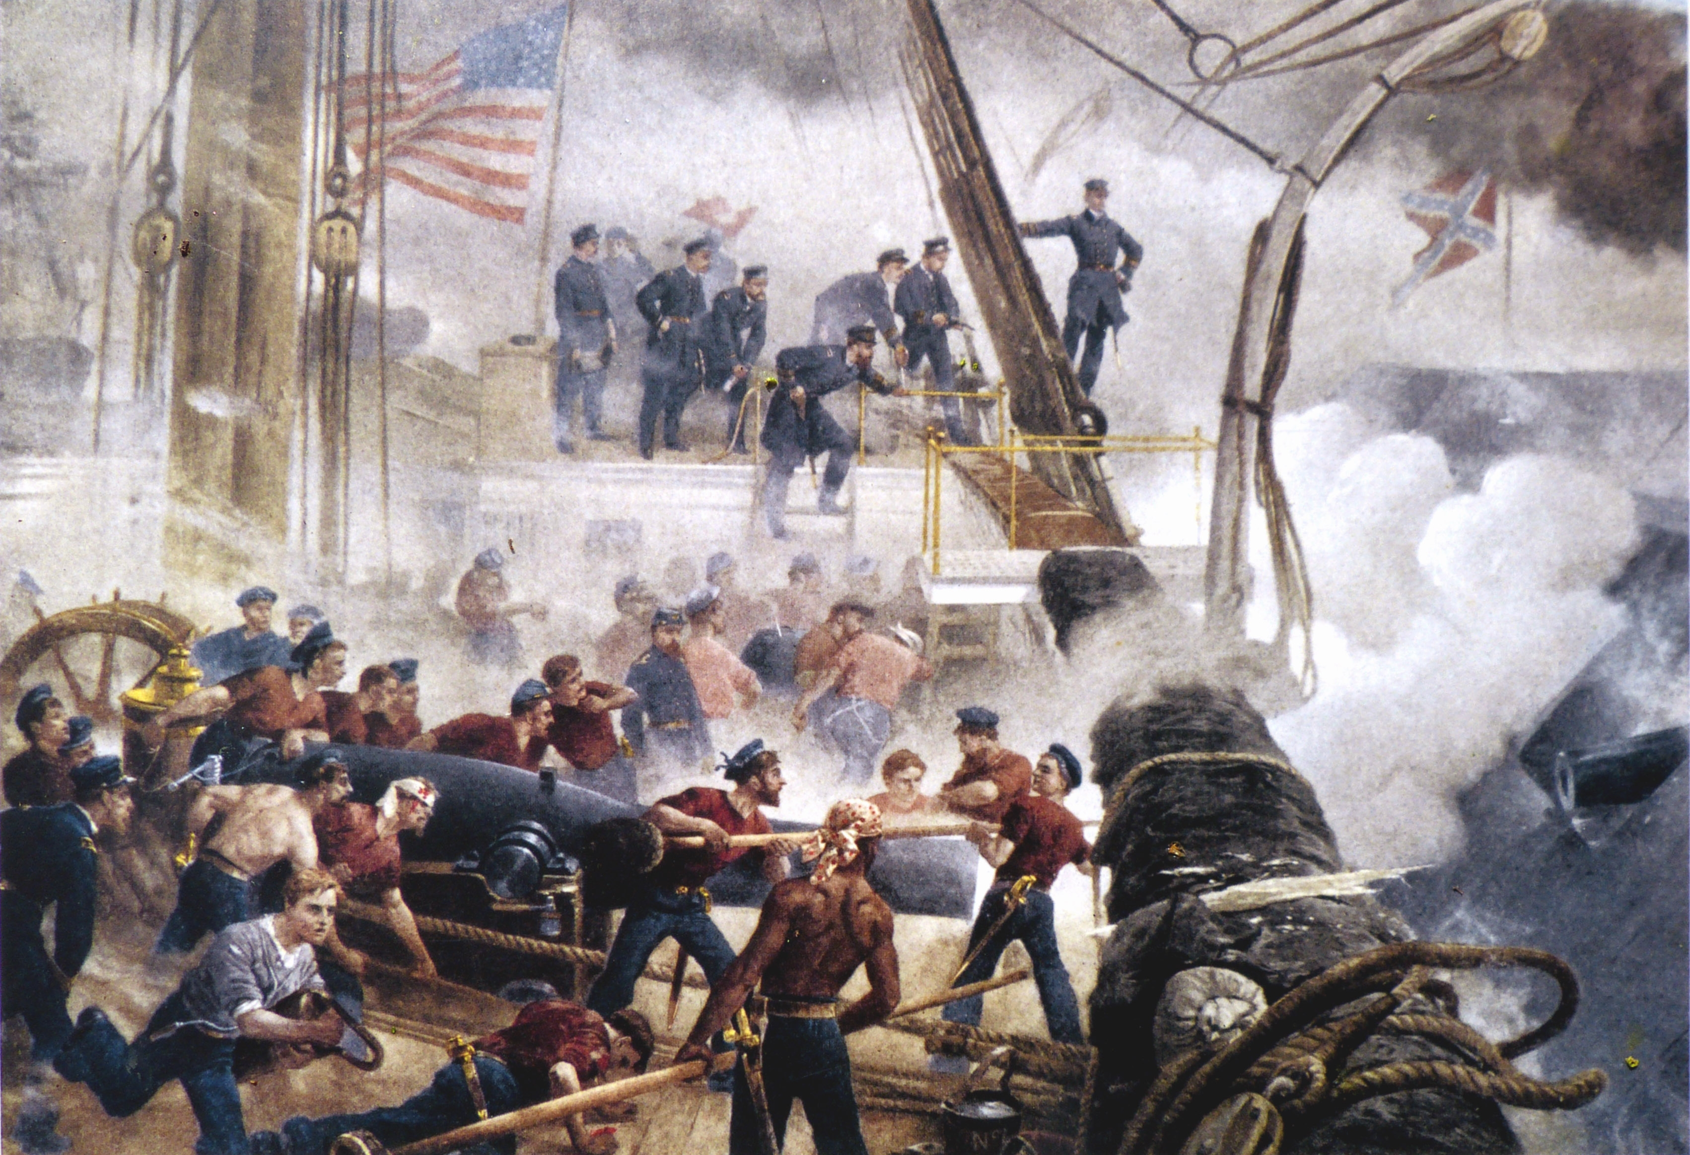
The Art and Science of Navigation
-Marine navigation both an art and science. -Union between precise mathematics and instincts…SEAMANSHIP! -Good navigator plans voyages carefully. -We must gather information as we progress and then evaluate position. -If we compare this position to our voyage plan, we can make decisions to: Avoid danger. Stay on track . Navigate safely. -Can’t learn everything from a book…you have to develop yourself from experience.
SEANAV I United States Naval Academy
NN220 – Fundamentals of Navigation
Operations Officer I HMS PROTECTOR A173 I The Ice Patrol Ship

Slide 14
Fundamental Terms and Definitions
Nautical Charts- Graphic representations of areas of the Earth, in digital or hard copy form, for use in marine navigation. Course-The horizontal direction in which a vessel is intended to be steered, measured from north at 000° clockwise though 360°. Heading-The direction in which a vessel is pointed at any given moment, expressed as angular distance from 000° clockwise through 360°. Bearing-The direction of one terrestrial point from another, expressed as angular distance from 000° clockwise through 360°. Is expressed as either true or relative bearing. Speed-The rate of motion, or distance per unit of time. In navigation we use Knot, or a rate of 1 NM (2,025.37 yards…we usually just say 2,000!) per hour. Lines of Position (LOP)-A line that is plotted on a chart with which our position lies. It may be taken from a visual aid, RADAR or a celestial sight reduction. Fix-A position derived from measuring external reference points, typically the intersection of three or more LOPs.
SEANAV I United States Naval Academy
NN220 – Fundamentals of Navigation
Operations Officer I HMS PROTECTOR A173 I The Ice Patrol Ship

Slide 15
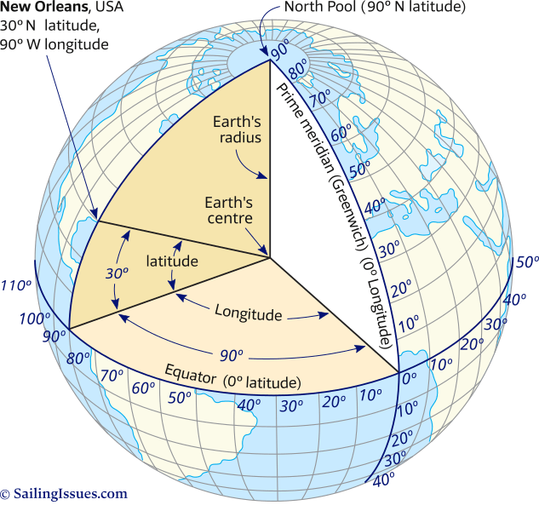
Terrestrial Coordinate System
Prime Meridian-The base line of Longitude from which all lines of longitude are measured from. Based in Greenwich, England and runs from True North to True South. Longitude-The angular distance between the Prime Meridian (base longitude) and the meridian of a point on Earth. Measured 000°-180° East or West of the Prime Meridian. Lines of Longitude are commonly referred to as meridians. Equator-A great circle at latitude 0° that bisects the Northern and Southern Hemisphere. Latitude-The angular distance from the Equator (base latitude) measured north or south from 000°-90° at the poles. Lines of Latitude are commonly referred to as Parallels.
SEANAV I United States Naval Academy
NN220 – Fundamentals of Navigation
Operations Officer I HMS PROTECTOR A173 I The Ice Patrol Ship

Slide 16
Terrestrial Coordinate System
-Latitude will be expressed in degrees, minutes and seconds followed by the suffix N/S. ᵠ = XXº XX’ XX’’ N/S -Longitude will be expressed in degrees, minutes and seconds followed by the suffix E/W λ = XXXº XX’ XX’’ E/W
SEANAV I United States Naval Academy
NN220 – Fundamentals of Navigation
Operations Officer I HMS PROTECTOR A173 I The Ice Patrol Ship

Slide 17
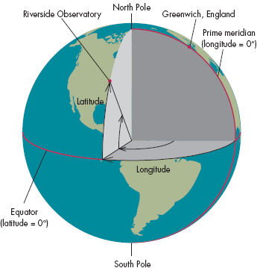
Terrestrial Coordinate System
-A combination of latitude and longitude is a position on the Earth’s Grid. -Example: Riverside Observatory coordinates: - Lat. = 33°57’ 12’’ N - Long. = 117°23’ 46’’ W
SEANAV I United States Naval Academy
NN220 – Fundamentals of Navigation
Operations Officer I HMS PROTECTOR A173 I The Ice Patrol Ship

Slide 18
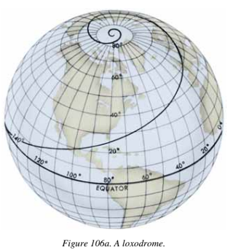
Rhumb Lines
-Rhumb Line-A line, typically drawn on a chart, that is making the same angle with all meridians. It has a path with constant bearing relative to true north. We plot rhumb lines on nautical charts to represent our track lines, lines of bearing, etc. These are plotted as straight lines. Rhumb lines that are Meridians and Parallels will maintain constant true directions, but since the Earth is round, any other rhumb line will eventually spiral towards the pole as it covers great distances, called a loxodromic curve or loxodrome. Rhumb lines work well on large scale charts!
SEANAV I United States Naval Academy
NN220 – Fundamentals of Navigation
Operations Officer I HMS PROTECTOR A173 I The Ice Patrol Ship

Slide 19
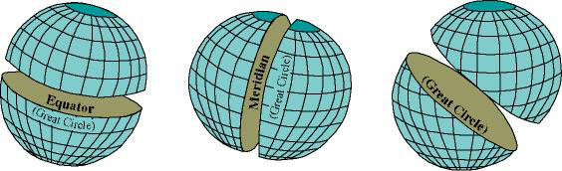
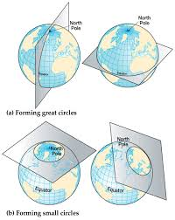
Great Circle Lines
-Great Circle Line-A line that represents the circular intersection of a sphere and a plane passing through the sphere’s center point. Any circle formed on the surface of Earth by the intersection of a plane passing through the center of the Earth, thereby dividing Earth into two equal parts. The Earth is round, and so by using spherical trigonometry, we find that the shortest distance between two points on the Earth is actually NOT a straight line, but a Great Circle!
SEANAV I United States Naval Academy
NN220 – Fundamentals of Navigation
Operations Officer I HMS PROTECTOR A173 I The Ice Patrol Ship

Slide 20
Types of Navigation
Bathymetric Navigation
Celestial Navigation
Dead Reckoning (DR)
Inertial Navigation
Piloting
Radio Navigation
Radar Navigation
Satellite Navigation
SEANAV I United States Naval Academy
NN220 – Fundamentals of Navigation
Operations Officer I HMS PROTECTOR A173 I The Ice Patrol Ship

Slide 21
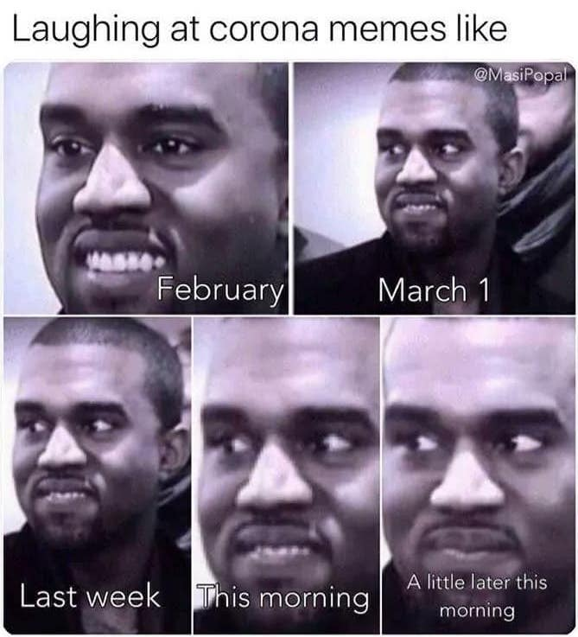
Thinking navigation be easy
Dead Reckoning
Inertial Navigation
Radio Navigation
Bathymetric navigation
Celestial Navigation
SEANAV I United States Naval Academy
NN220 – Fundamentals of Navigation
Operations Officer I HMS PROTECTOR A173 I The Ice Patrol Ship

Slide 22
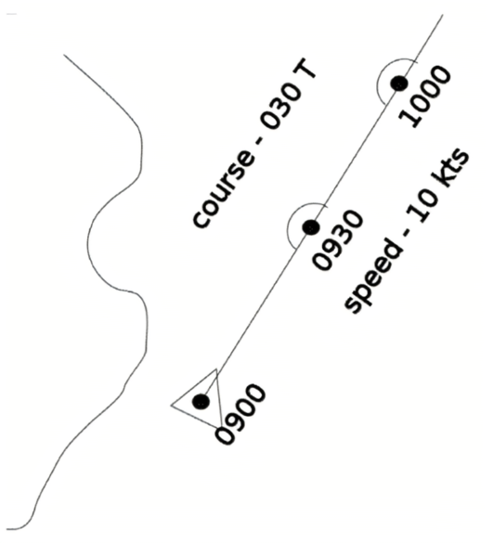
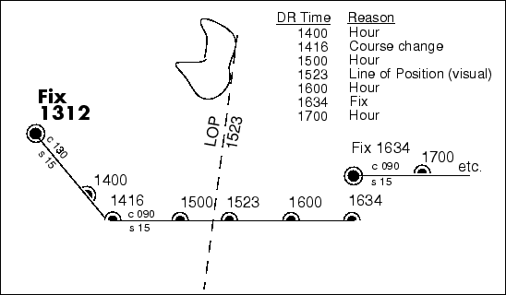
Types of Navigation (that we will focus on!)
Dead Reckoning (DR)-Determines a predicted position by advancing a known position for courses and distances.
SEANAV I United States Naval Academy
NN220 – Fundamentals of Navigation
Operations Officer I HMS PROTECTOR A173 I The Ice Patrol Ship

Slide 23
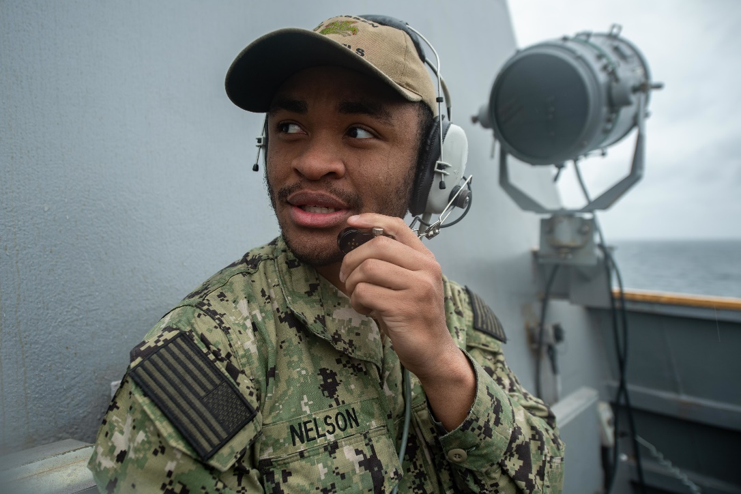
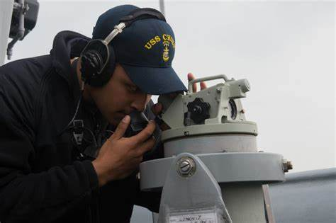
Types of Navigation (that we will focus on!)
Piloting-Involves navigating in restricted waters with frequent or constant determination of position relative to nearby geographic and hydrographic features.
SEANAV I United States Naval Academy
NN220 – Fundamentals of Navigation
Operations Officer I HMS PROTECTOR A173 I The Ice Patrol Ship

Slide 24
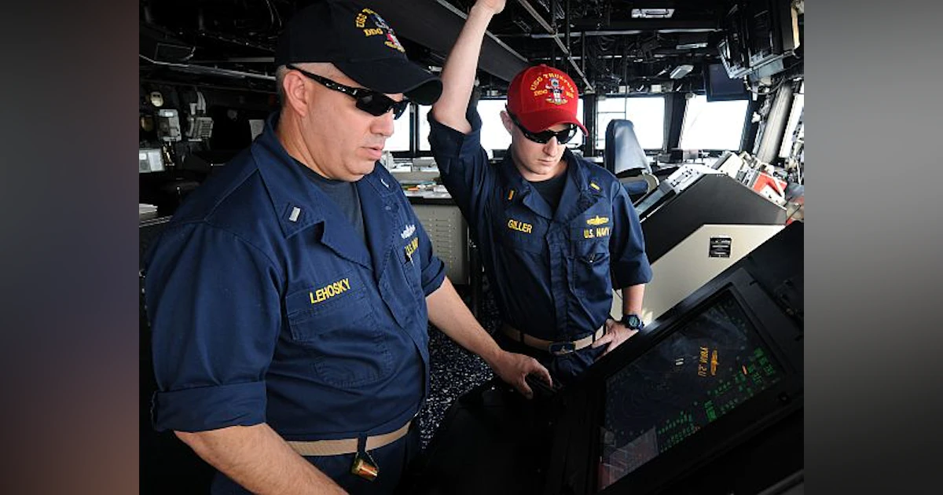
Types of Navigation (that we will focus on!)
RADAR Navigation-Involves using RADAR to determine the distance from or bearing to objects whose position is known. This is separate from collision avoidance!
SEANAV I United States Naval Academy
NN220 – Fundamentals of Navigation
Operations Officer I HMS PROTECTOR A173 I The Ice Patrol Ship

Slide 25
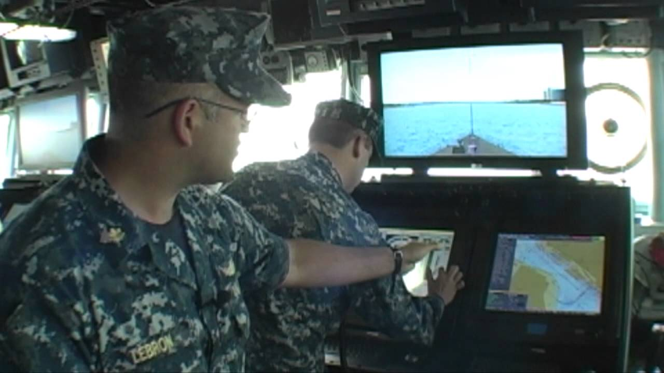
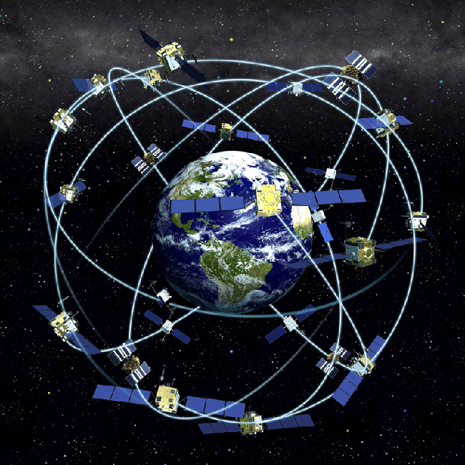
Types of Navigation (that we will focus on!)
Satellite Navigation-Uses radio signals from satellites to determine position.
SEANAV I United States Naval Academy
NN220 – Fundamentals of Navigation
Operations Officer I HMS PROTECTOR A173 I The Ice Patrol Ship

Slide 26
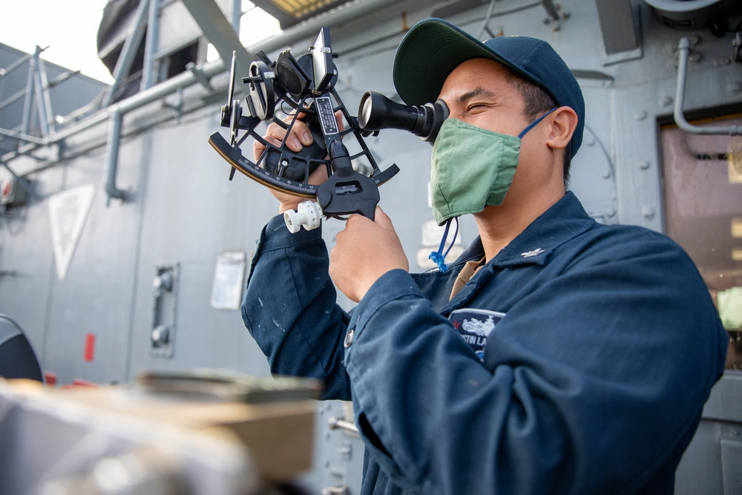
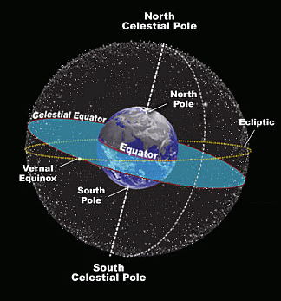
Types of Navigation (that we will focus on!)
Celestial Navigation-Involves reducing celestial measurements taken with a sextant to lines of position utilizing spherical trigonometry either by hand or with computer programs.
SEANAV I United States Naval Academy
NN220 – Fundamentals of Navigation
Operations Officer I HMS PROTECTOR A173 I The Ice Patrol Ship

Slide 27
The Phases of Navigation
The Surface Ship Navigation Department Organization and Regulations Manual, or NAVDORM, details the four phases of navigation: Restricted Waters-Navigating less than 2 nautical miles from land or shoal water, typically in narrow canals, channels, rivers and estuaries. Piloting Waters-Navigating within 2-10 nautical miles of land or shoal, typically as we go to a harbor entrance or through bays and sounds and negotiating harbor approach channels. Coastal Waters-Navigating within >10-30 nautical miles of land or shoal water. Open Ocean-Navigating over 30 nautical miles away from land or shoal water.
SEANAV I United States Naval Academy
NN220 – Fundamentals of Navigation
Operations Officer I HMS PROTECTOR A173 I The Ice Patrol Ship

Slide 28
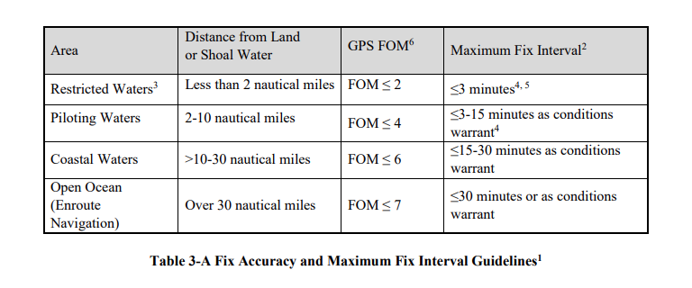
Table 3-A
SEANAV I United States Naval Academy
NN220 – Fundamentals of Navigation
Operations Officer I HMS PROTECTOR A173 I The Ice Patrol Ship

Slide 29
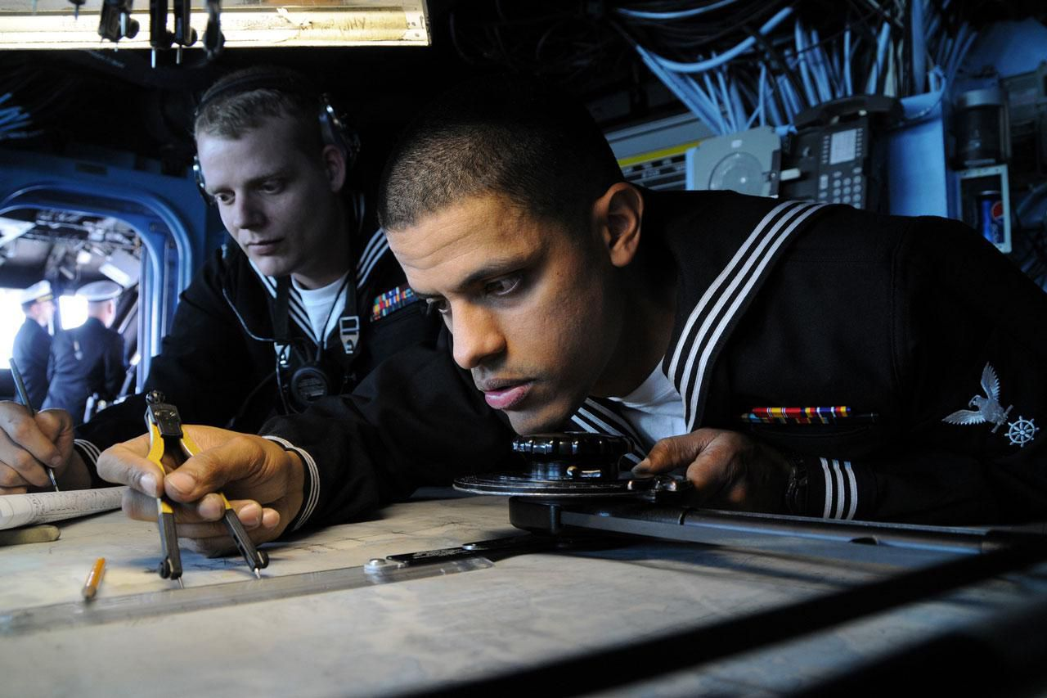
Navigation Organizations
-Governments organizations around the world fund, operate, and regulate navigation, both locally and internationally. -In the U.S., there are multiple organizations that manage policy, build and operate navigation systems and maintain the aids to navigation that we use. -Many other maritime nations have similar national organizations. -Understanding the government’s role in supporting and regulating navigation is especially important to the navigator, as it will provide guidance.
SEANAV I United States Naval Academy
NN220 – Fundamentals of Navigation
Operations Officer I HMS PROTECTOR A173 I The Ice Patrol Ship

Slide 30

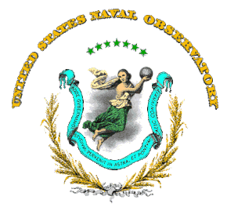
U.S. Organizations
The National Geospatial-Intelligence Agency (NGA)-Produces charts and nautical publications used extensively by the U.S. Military. Disseminates maritime safety information in the form of Notice to Mariners (NTM). The United States Naval Observatory (USNO)-Scientific and military facility that produces geopositioning, navigation and timekeeping data for the United States Navy and the United States Department of Defense. It is one of the oldest scientific agencies in the United States, and remains the country's leading authority for astronomical and timing data for all purposes
SEANAV I United States Naval Academy
NN220 – Fundamentals of Navigation
Operations Officer I HMS PROTECTOR A173 I The Ice Patrol Ship

Slide 31

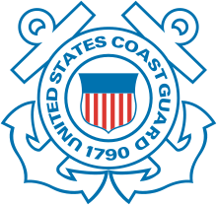
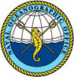
U.S. Organizations
National Oceanic and Atmospheric Administration (NOAA)-Produces charts and nautical publications used extensively by both the Navy and Merchant fleets. Primarily covers the coastal areas of the US and Great Lakes. The United States Coast Guard (USCG)- Maintains aids to navigation, provides updates for Navigation Warnings for US Districts and produces Local Notice to Mariners. Publishes the Rules of the Road book that we use! National Oceanographic Office (NAVOCEANO)-Provides oceanographic products and services to all elements within the Department of Defense.
SEANAV I United States Naval Academy
NN220 – Fundamentals of Navigation
Operations Officer I HMS PROTECTOR A173 I The Ice Patrol Ship

Slide 32
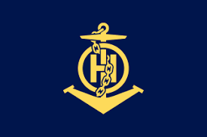


International Organizations
International Hydrographic Organization (IHO)-Sets forth hydrographic standards to be agreed upon by member nations. Ensures nautical charts produced by different nations have uniformity in design. International Maritime Organization (IMO)- Coordinates international policy on maritime matters. Adopts conventions and protocols for safety at sea, such as International Regulations for Preventing Collisions at Sea (COLREGS)…or the Rules of the Road! The International Association of Marine Aids to Navigation and Lighthouse Authorities (IALA)-Provides technical coordination, information sharing and coordination of improvements to visual aids to navigation around the world.
SEANAV I United States Naval Academy
NN220 – Fundamentals of Navigation
Operations Officer I HMS PROTECTOR A173 I The Ice Patrol Ship

Slide 33
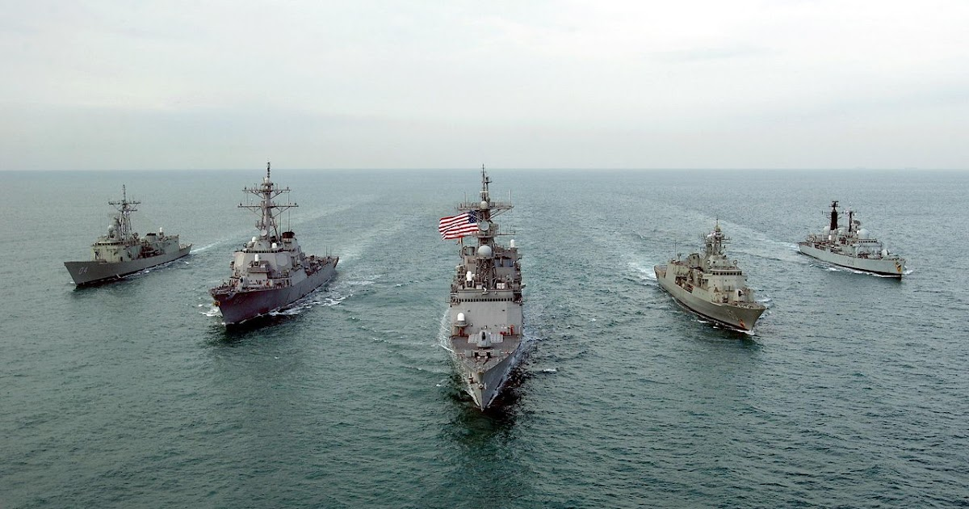
U.S. Navy Role in Navigation
The role of the U.S. Navy in the development of navigation technology is singular. The development of almost every device known to navigation science has been deeply influenced by Naval policy. From the founding of USNO to the development of some of the most advanced navigation systems, such as GPS and the emergence of electronic navigation, the U.S. Navy remains a leader in developing devices and techniques designed to keep navigators safe.
SEANAV I United States Naval Academy
NN220 – Fundamentals of Navigation
Operations Officer I HMS PROTECTOR A173 I The Ice Patrol Ship

Slide 34
Back to
Fundamentals
-We cannot default to electronic and computer systems.
-Sophisticated navigation systems should not prevent us from doing fundamental navigation.
-Understanding of the basics is key to understanding irregularities and avoiding disaster.
-There have been many mishaps that have occurred from lack of understanding of basic navigational principles.
SEANAV I United States Naval Academy
NN220 – Fundamentals of Navigation
Operations Officer I HMS PROTECTOR A173 I The Ice Patrol Ship

Slide 35
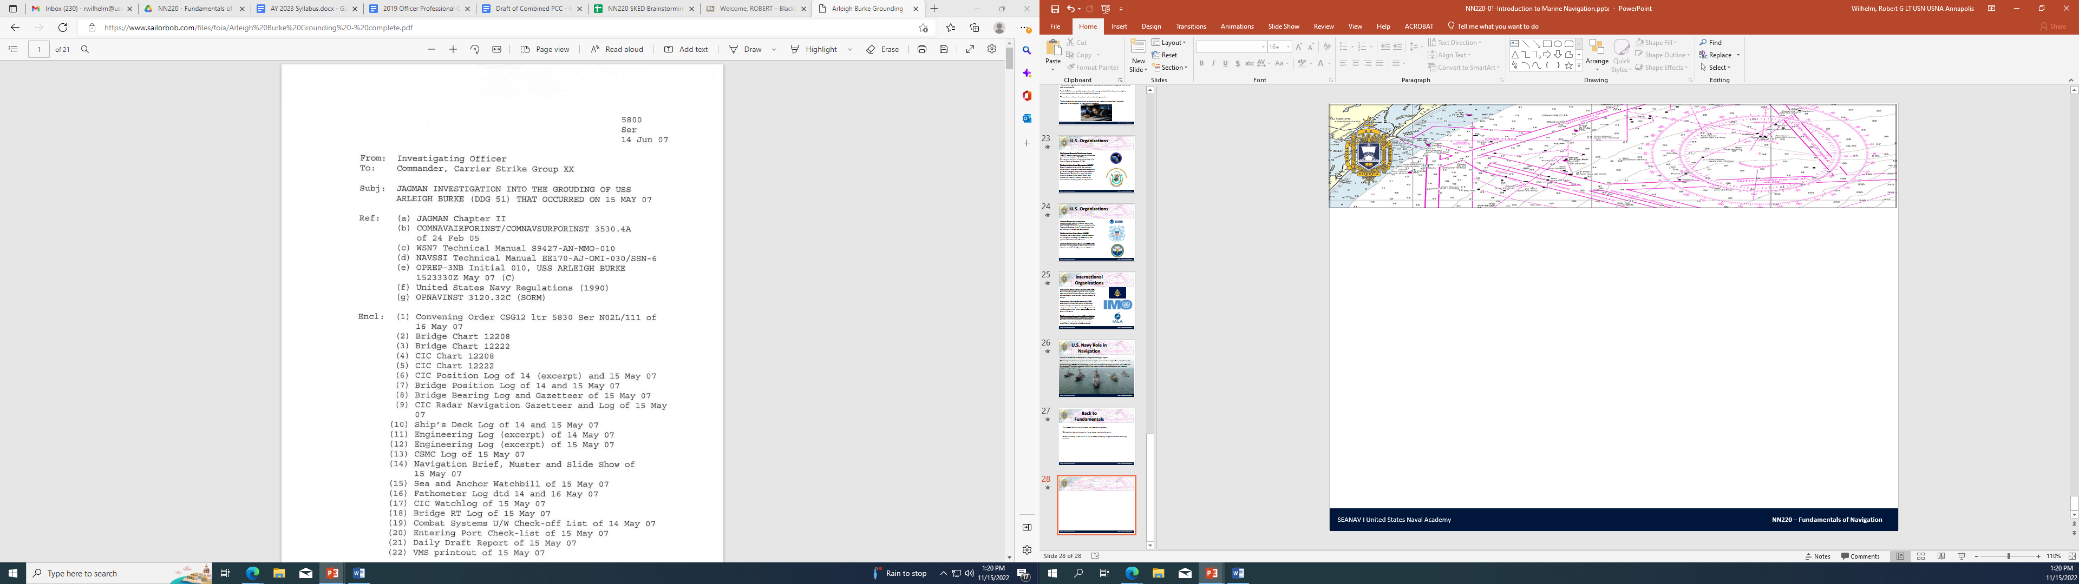
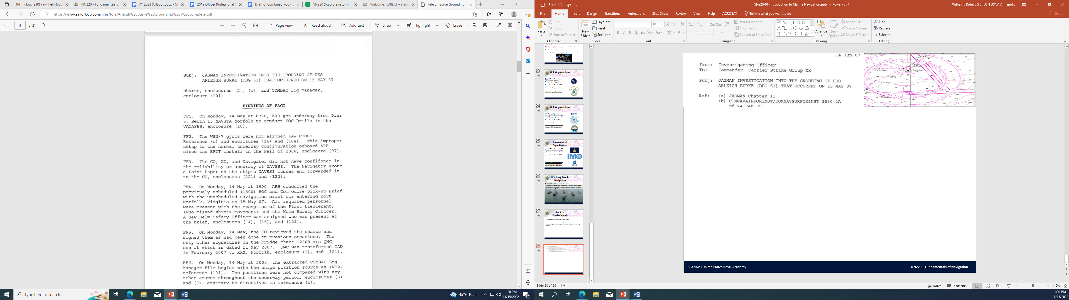
SEANAV I United States Naval Academy
NN220 – Fundamentals of Navigation
Operations Officer I HMS PROTECTOR A173 I The Ice Patrol Ship

Slide 36
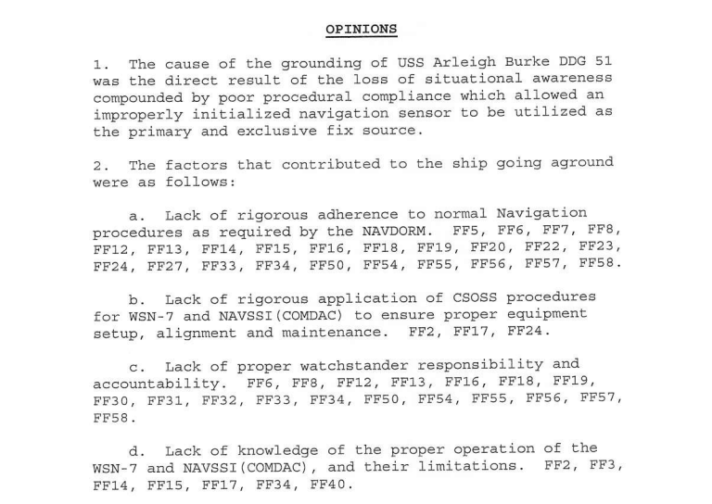
SEANAV I United States Naval Academy
NN220 – Fundamentals of Navigation
Operations Officer I HMS PROTECTOR A173 I The Ice Patrol Ship

Slide 37
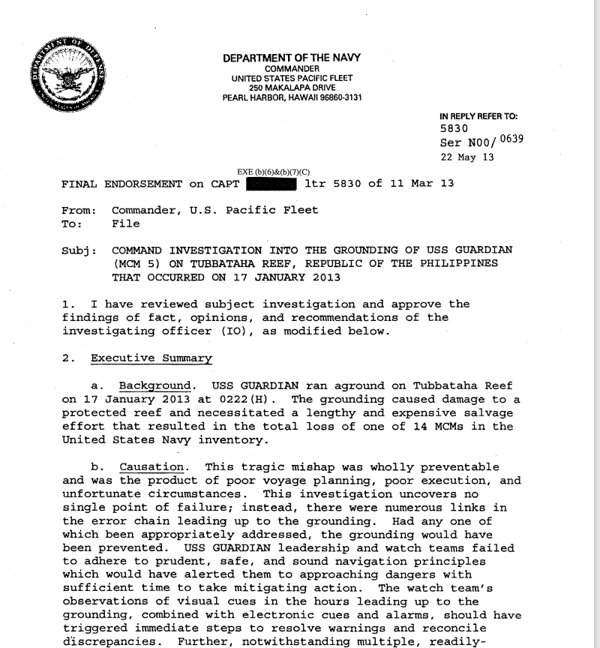
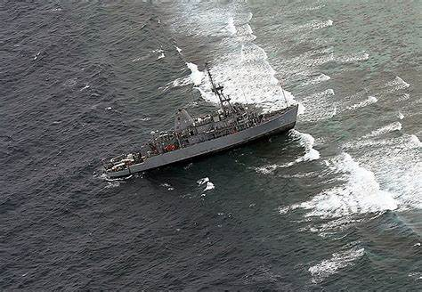
SEANAV I United States Naval Academy
NN220 – Fundamentals of Navigation
Operations Officer I HMS PROTECTOR A173 I The Ice Patrol Ship

Slide 38
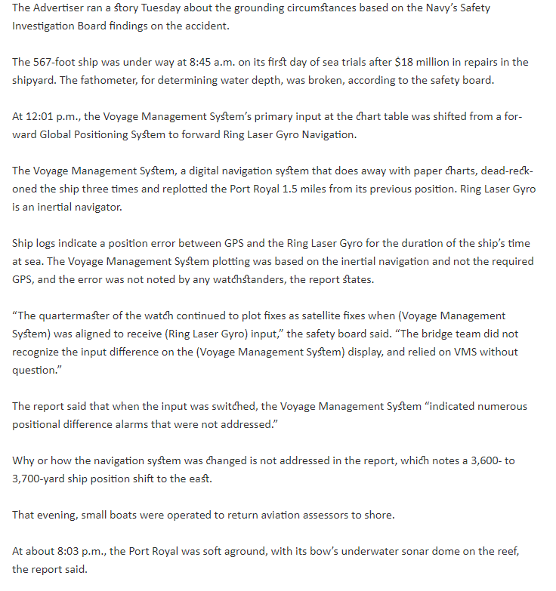
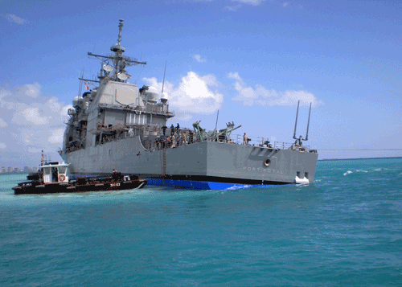
SEANAV I United States Naval Academy
NN220 – Fundamentals of Navigation
Operations Officer I HMS PROTECTOR A173 I The Ice Patrol Ship

Slide 39
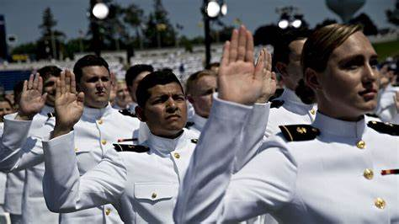
Questions?
SEANAV I United States Naval Academy
NN220 – Fundamentals of Navigation
Operations Officer I HMS PROTECTOR A173 I The Ice Patrol Ship

